Slide 1
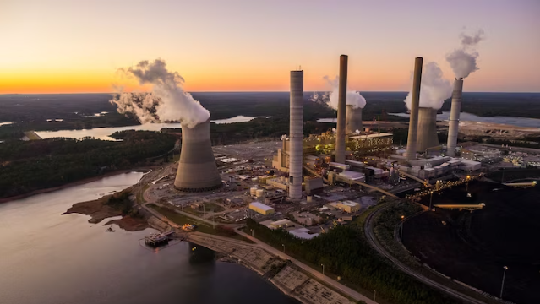
Energy Consumption Analysis
Domain: Energy and Sustainability

Slide 2

Problem Statement :
Project will analyse energy usage and greenhouse gas (GHG) emissions of Ontario's Broader Public Sector (BPS) organizations, leveraging a comprehensive database of reported data. We aim to identify trends, assess conservation effectiveness, and pinpoint areas for improvement, informing data-driven strategies to achieve climate change mitigation goals within the BPS.

Slide 3

Tools Used
Jupyter Note Book
Pandas – Python
Excel
Power BI

Slide 4
Approaches :
The Dataset spans from 2012 to 2021 and contains information about BPS organizations, including public hospitals and school boards. Key attributes include organization details, operational information, energy consumption data, and GHG emissions.
Dataset link :https://data.ontario.ca/dataset/energy-use-and-greenhouse-gas-emissions-for-the-broader-public-sector
This is a year wise dataset, First we need to collect all the data (Download)
Properly renaming the columns which are required to get insights in all the datasets
Check for null values and units of measure
Treating Null Values and unit Conversion
Transform the Cleaned data into Excel file to proceed further Analysis

Slide 5
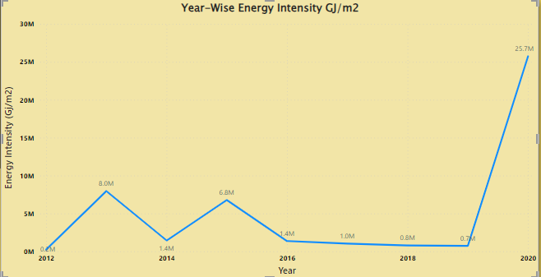
EDA Insights :
The Total Energy Usage in the year 2020 was too high
The Average GHG Emission in Public Hospitals was very high in 2020 which is around 1.84 Million KG

Slide 6
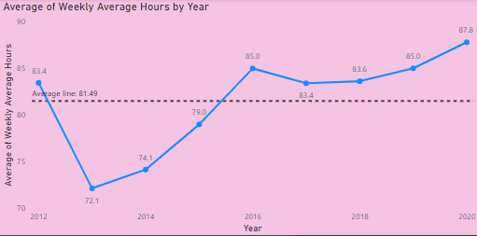
The Average Weekly Working Hour in 2013 was the lowest ( 72.1 hrs ) and it increases drastically till 2016 ( 85 hr ) and then decreases in 2017 thereafter gradually increases

Slide 7
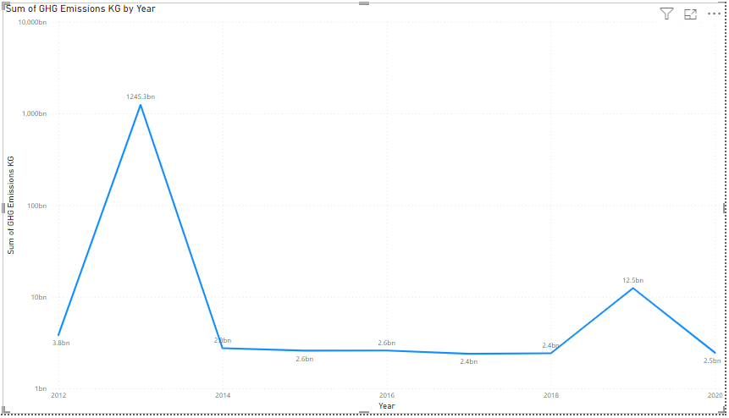
The Green House Gas Emission was very High in 2013 (1245.3 billion)
From 2014 to 2018 it was maintained under 2.5 bn
In 2019 it took an increase in 6 times comparing to previous year
In 2020 it came back around 2.3 billion KG

Slide 8

Conclusion :
School Board Sector has emitted huge amount of GHG up to 2020 and in 2021 Municipal Sector becomes the most GHG emitter Around 1.34 million metric tons of GHG
Fuel Oil 1 and 2 was consumed in more quantity 334.86 billion litres up to 2020

